Slide 1
Design Patterns
Software Engineering
CS 561

Slide 2
Last Time
Introduced design patterns
Abstraction-Occurrence
General Hierarchy
Player-Role

Slide 3
This Time
Singleton pattern
Observer pattern
Delegation pattern
Adapter pattern
Façade pattern
Immutable pattern
Read-Only Interface pattern
Factory pattern

Slide 4
Singleton
Context
  Common to want only one instance of a class
  Referred to as a singleton
  E.g. a Company or University class
Problem
  How to ensure only one instance
Forces
  Public constructor will not guarantee only one instance
  Constructor must be accessible to all classes that need it, though.

Slide 5
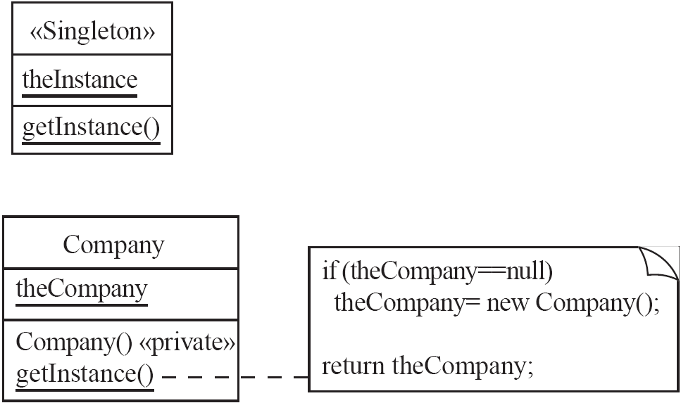
Singleton
Solution
  Use a private class variable for one (the) instance of the class
  Use a public static class method runs the constructor only on its first call, and make the constructor private

Slide 6
Observer
Context
  Two way associations make code for pairs of classes inseparable
  Need both classes for reuse
Problem
  How to reduce interconnection between classes
  How to ensure communication with other objects without knowing what class they belong to
Forces
  Maximize flexibility

Slide 7
Observer
Solution
  Create abstract class called <<Observable>>
  Includes mechanism to add and remove observers
  Method to send an update message to each <<Observer>>
  Allow any application class to be <<Observable>>
<<Observer>> is an interface with an abstract update method

Slide 8
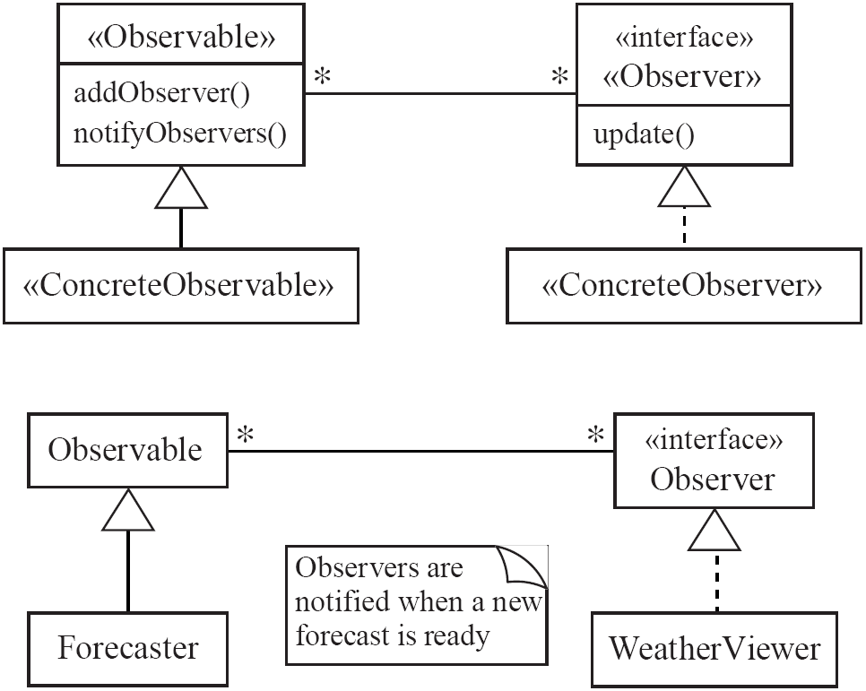
Observer

Slide 9
Observer
Examples
  A Forecaster object would perform many calculations
  WeatherViewer is needed to obtain values from this object
  Java contains an Observer interface and an Observable class
Anti-patterns
  Connecting an observer directly to something that is observable
  Making observers subclasses of what is observable

Slide 10
Delegation
Context
  Creating a method for a class
  Another class already has that operation
  Inheritance should not be used because the “is-a” rule does not apply
Problem
  Effectively make use of a method existing in another class
Forces
  Development costs should be minimized by reusing methods from other classes
  Ensure work is completed by an appropriate class

Slide 11
Delegation
Solution
  Create a <<Delegator>> class that calls a method in an associated <<Delegate>> class
  Typically an association already exists between the <<Delegator>> and the <<Delegate>>
  Sometimes such an association is created if it reduces system complexity
  Delegation could be viewed as a form of selective inheritance
  Some languages like C# support delegates using a keyword

Slide 12
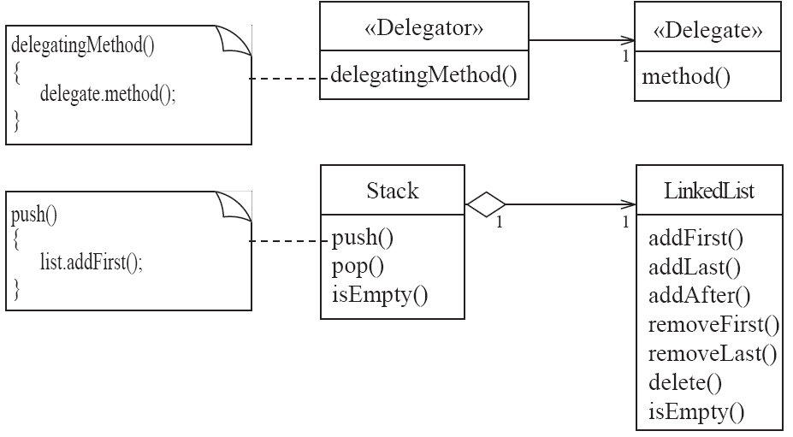
Delegation

Slide 13
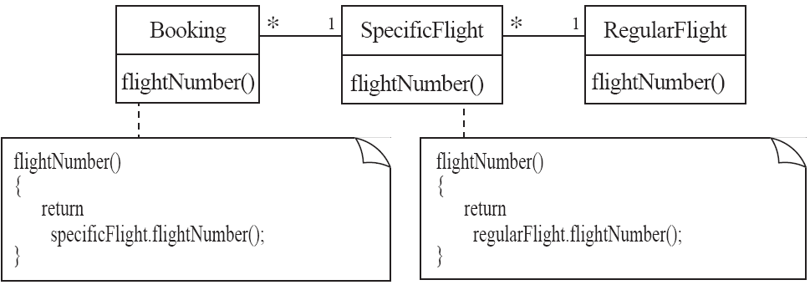
Delegation

Slide 14
Delegation
Anti-patterns
  Common to inherit method to be reused instead of delegating it
  Should avoid duplicating code unless necessary
  Should avoid directly accessing code within the delegate class that is outside of the delegated method

Slide 15
Adapter
Context
  Incorporate an existing class into an inheritance hierarchy
  Methods may have different names and class may be part of its own inheritance hierarchy
Problem
  How to use polymorphism when reusing a class with the same functionality but a different signature
Forces
  Assume multiple inheritance does not exist

Slide 16
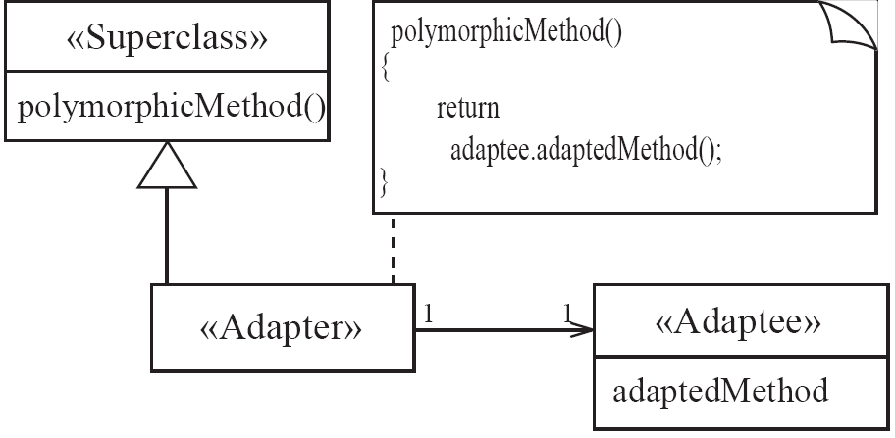
Adapter
Solution
  Create an <<Adapter>> class that connects via association to an <<Adaptee>>
  The methods of <<Adapter>> delegate to those of the <<Adaptee>>
  Sometimes called a wrapper class

Slide 17
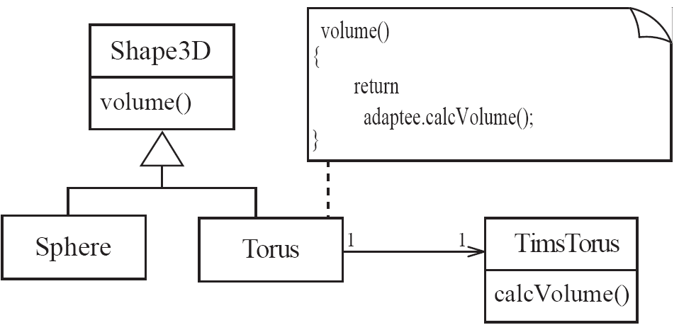
Adapter

Slide 18
Façade
Context
  Need to manipulate many different classes in many packages
Problem
  Simplify the programmer’s view of these packages
Forces
  Often hard to understand and use an entire subsystem
  Modifications made to the package would necessitate a complete review of its subsystems

Slide 19
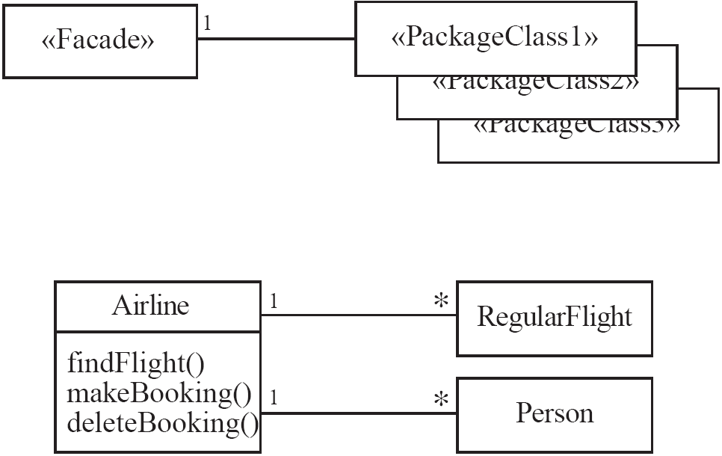
Façade
Solution
  Use a <<Façade>> class to simplify use of the package(s)
  Create a simplified set of public methods to interact with the package(s)
  Changes should only need to be made to the <<Façade>> rather than the package(s)

Slide 20
Immutable
Context
  Immutable object has a state that never changes after creation – e.g. a Java String
  Content can be trusted to not change unexpectedly
Problem
  How to create a class with immutable instances
Forces
  Immutability must be enforced
  Don’t allow loopholes
Solution
  Only allow instance variables to be modified within the constructor
  Instance methods should have no side effects
  Instead of using side effects to modify instance variables, instance methods should create a new instance of the class and return a new object with new values containing the results of the side effect

Slide 21
Read-Only Interface
Context
  Create a privileged class that may modify attributes of objects that are otherwise immutable
Problem
  How to create a situation where some classes see another as read-only
Forces
  Java allows access control by public, private, and protected keywords, but public access still allows read and write access
Solution
  Create a <<Mutable>> class that you may pass instances of to methods that are allowed to make changes
  Allow associations to unprivileged classes only through a <<ReadOnlyInterface>>

Slide 22
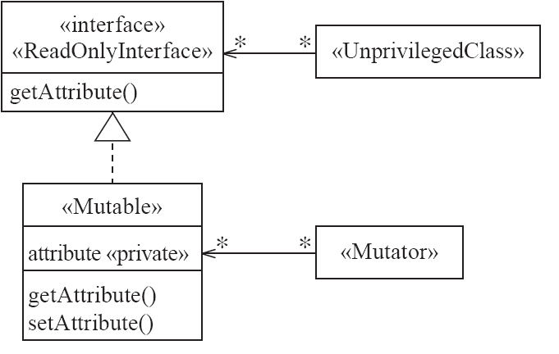
Read-Only Interface

Slide 23
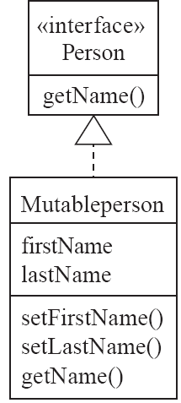
Read-Only Interface

Slide 24
Proxy
Context
  Sometimes it is time consuming or complicated to create instances of a class that has lots of data (a heavyweight class)
  Could cost CPU time, memory usage, etc.
Problem
  Reduce the need to create instances of such classes
Forces
  Want availability of such heavyweight objects without the cost
  Persistence of these objects from run to run is key
Solution
  Create a simpler version of the <<HeavyWeight>> class called a <<Proxy>>
  The <<Proxy>> has the same interface as the <<HeavyWeight>>

Slide 25
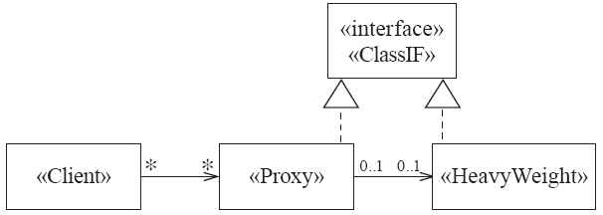
Proxy

Slide 26
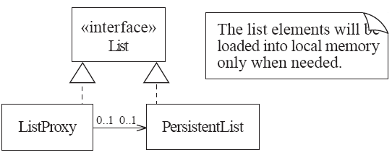
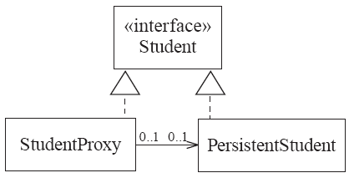
Proxy

Slide 27
Factory
Context
  Have reusable framework that creates objects but created objects depend upon the application
Problem
  Allow programmer to add an <<ApplSpecificClass>> into the framework
  Allow framework to instantiate this class without modifying the framework
Forces
  Want framework benefits and flexibility of having the framework to create and work with application-specific classes that the framework does not yet know about
Solution
  Framework delegates creation of instances of <<ApplSpecificClass>> to a specialized class <<ApplSpecificFactory>>
  <<ApplSpecificFactory>> implements a generic <<Factory>> interface that is predefined within the framework
  <<Factory>> contains an abstract method called createInstance that is implemented by <<ApplSpecificFactory>>
  A <<CreationRequester>> declares a method to create a <<Factory>> of <<GenericClass>> which can be carried out with an <<ApplSpecificFactory>> and an <<ApplSpecificClass>>

Slide 28
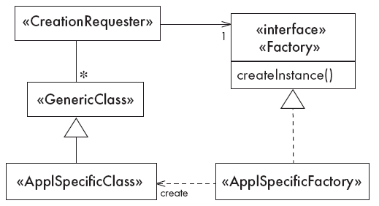
Factory

Slide 29
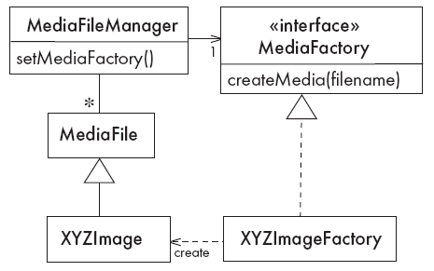
Factory

