Slide 1
Memory Management
Operating Systems
CS550

Slide 2
Memory Manager
Memory manager - manages allocation and de-allocation of main memory
Plays significant impact on operating system because it is so important to performance
Primitive in systems without multiprogramming
Use small blocks of storage that are located in physical memory in non-contiguous places
Virtual memory management provides abstraction of memory space used by a program Independent of how memory is implemented on device

Slide 3
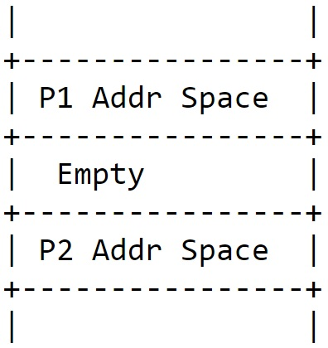
Process Address Space
Set of logical addresses a process references in its code
Given mechanism to map logical addresses to physical via OS
Logical addresses bound to physical upon allocation
Symbolic addresses - used in source program (variable names, etc)
Relative addresses - compiler converts symbolic to these
Physical addresses - final address generated when program is loaded into phys. mem. generated by loader

Slide 4
Binding
With compiled language - C/C++, Fortran, etc., compiler translates source with symbolic addresses to object code in machine language with relative/ relocatable addresses (i.e. offsets)
Linker combines object program with other necessary object modules into an absolute program with logical addresses
Editor
Compiler/Assm
Linker
Loader
Physical Address
Symbolic Address
Relative Address
Relative Address
Other Compiled Modules

Slide 5
Memory placement strategies
Fetch strategies - when to move program/data into main memory (demand/anticipatory)
Placement strategies - where to put incoming program/data
First Fit
Best Bit
Worst Fit
Replacement strategies - when memory is too full or fragmented need to remove some of program or data
These are difficult to use in multiprogramming environment
Must keep track of contiguous allocations (fragmentation possible), compact memory, etc.
Need virtual memory, segmentation, and paging
Have physical and virtual addresses

Slide 6
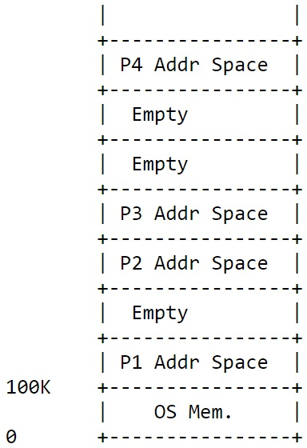
Memory Partition
This can be done contiguously or non-contiguously.
Because there are many problems like internal fragmentation with contiguous allocation, we will avoid it. (problems with fixed size holes)
And focus on dynamic partitioning.

Slide 7
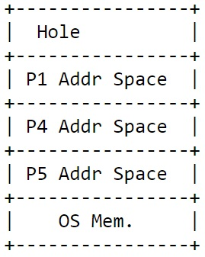
Dynamic partitioning (still contiguous)
Use variable size partitions
Create when sufficient memory available
Number of partitions variable
Blocks of available memory called holes
Still have fragmentation, but it is external
Can do compaction
Use dynamic relocation to relocate processes in memory even after starting program

Slide 8
Dynamic partitioning (contd..)
Swapping necessary, too
When a process is blocked (e.g for I/O) can swap to disk and use memory for something else
Must take less time to swap than to spend in blocked state
Performance is affected by swapping

Slide 9
Non-contiguous allocation
Helps to remove fragmentation
Use paging and segmentation
Paging :
Divide process address space into small fixed size blocks of logical memory called pages
Process size thus measured in number of pages
Physical memory divided into frames
Page size is a power of 2
Typically one page to one frame

Slide 10
Non-contiguous allocation

Slide 11
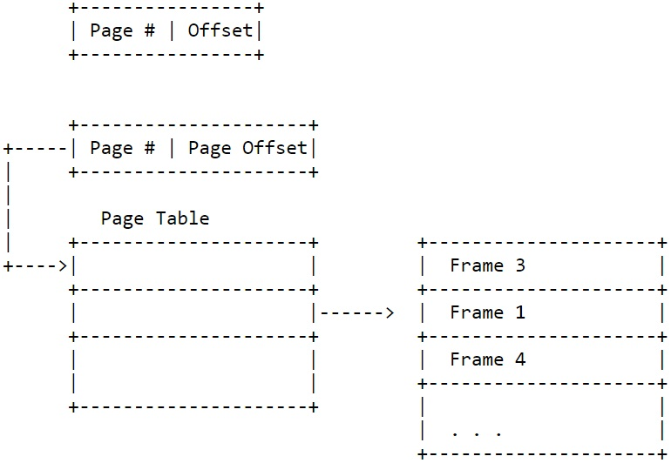
Logical Addressing
Logical address is a page number and an offset

