Slide 1
Scheduling Policies and File Systems
Operating Systems
CS 550

Slide 2
Last lecture
Review of Round Robin (RR) and Shortest Remaining Time First (SRTF)
Examples and Performance
Dynamic Priority Scheduling
Description
Heuristic algorithm

Slide 3
This time
Longest Job First
Real-time scheduling
Multi-level scheduling
Multiprocessor scheduling
A start on file systems

Slide 4
Longest Job First (LJF)
Same concept as SJF except using the longest job first
Uses a priority queue
Non-preemptive, not fair compared to FCFS
Example with five processes having CPU burst times of 148ms, 135ms, 125ms, 102ms, and 56ms
0 | 148 | 283 | 408 | 510 | 566
P1 | P2 | P3 | P4 | P5

Slide 5
Real-time (RT) scheduling
RT systems continuously interact with external environment
Behavior defined by timing constraints
Want fast response to high priority RT processes
Processes have deadline requirements
Must complete service before deadline expires

Slide 6
RT Scheduling
Could be periodic or sporadic
Periodic starts every p time units
Has computation time requirement c and deadline d
Sporadic spurred by random event
Must start and complete before deadline
2 policies exist
Rate Monotonic Scheduling
Process priorities assigned statically in reverse order of period length
Higher priority for shorter periods
Earliest Deadline First
Priorities assigned statically or dynamically
Processes with earlier deadlines given higher priorities

Slide 7
Multilevel Queues and Multiple Processors
May have several classes of processes in multiclass systems with different priorities
Use priority scheduling that can be either preemptive or non-preemptive
Need multilevel queues because each category of process needs its own queue
For example, batch processes may need one queue while interactive processes may need another queue

Slide 8
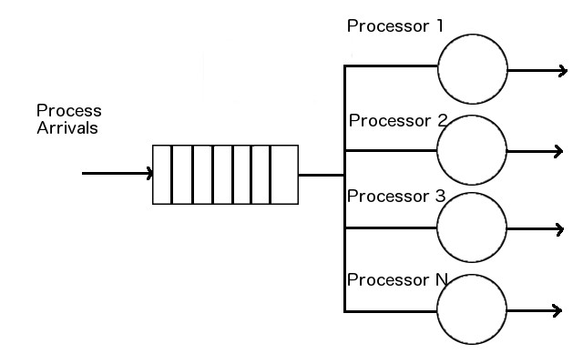
Multiple Processors, Single Queue Scheduler

Slide 9
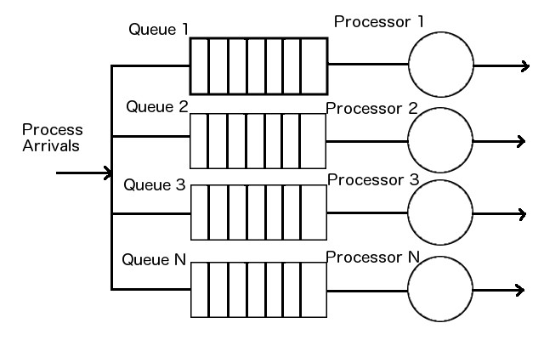
Multiple Processors, Multiple Queue Scheduler

Slide 10
File Management and IO
OS must allow users to
Store data in files
Find and use previously created files
File management subsystem provides this service
May be quite simple
Typically utilizes a tree structure
File – sequence of bytes stored on a device (e.g. HDD) on the computer
File management system often does not know how the file is stored
Application dependent

Slide 11
File Management Basics
OS may have its own files for which it knows the structure
Swap file (used by memory manager)
Audit log (used to keep track of system errors, etc.)
Management systems for these files often know about the structures of the files they create

Slide 12
Memory Basics
Computer has volatile and non-volatile memory
Volatile – contents lost if power is lost
Cache
Main memory (RAM)
Non-volatile – contents retained even without power
HDD
Flash memory
CD/DVD/Blu-ray

Slide 13
File Management Details
Basic file mechanisms
File name
Folders/directories (groups of files)
File attributes (aside from file name)
Size – amount of data stored
Location – where stored on computer
Type – what type of data
Usually denoted with file extension
Often have file associations to denote what program to execute when opening a file
Permissions – who can use the file
What can users do with the file
Read/write/execute rwxrwxrwx on Unix/Linux
Refers to owner, group, and world
Timestamp – when the file was created

Slide 14
File Management Details Continued
Attributes stored in folder containing the file data
Data stored as a directory entry
Pathnames – how to find file in directory tree
/usr/local/openmpi-1.6.3
C:\Program Files\...

Slide 15
File IO
Access methods
Sequential
Random (i.e. direct)
Process operations on files
Read
Write
Open
Close

Slide 16
Opening and Closing Files
Open
OS must search for file
Ex. fopen in C, Scanner and File classes in Java
Close
Close files when finished with them
Need to tell OS we are finished otherwise problems may occur
Ex. fclose in C and .close() methods in Java

Slide 17
Reading from Files
Which file?
Where is the data within the file?
Where in the memory space of the process should the file be stored?
How much data to read?

Slide 18
Writing to Files
Again, which file? Does it exist?
Where should the data be stored within the file?
Where is the data buffer?
How much data to write

