Slide 1
CPU Scheduling
Operating Systems
CS 550

Slide 2
Last Time
Deadlock Detection and Recovery
Methods to handle deadlock
  Ignore it!
  Detect and Recover
  Avoidance (Banker’s Algorithm)
  Prevention (prevent a condition for deadlock from occurring)

Slide 3
This Time
Discussion of CPU scheduling
What is scheduling?
Types of scheduling
Policies
Functions of the scheduler
Discussion and examples of different types of policies

Slide 4
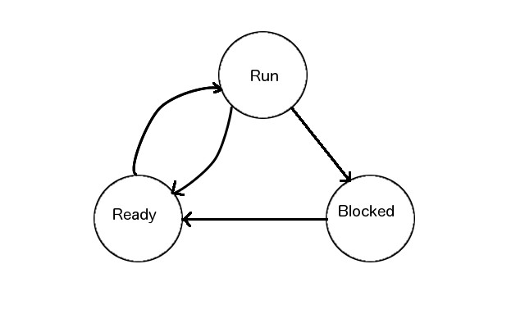
CPU Scheduling
OS scheduler must allow for allocation and de-allocation of CPU(s) to processes and threads
Must be efficient and effective
Many policies exist to decide which process/thread should be moved from ready to run first
Effectively the scheduler decides when and how to carry out a context switch

Slide 5
Assumptions
We will assume all processes that need the CPU will:
  Get in ready queue and wait for the CPU
  Execute a CPU burst for a fixed duration
  Wait for IO or go back to the ready queue to wait for the CPU again

Slide 6
Types of Scheduling
Long term
  Determining when to start jobs
Medium term
  Swapping processes in and out of memory
Short Term (our current focus)
  CPU Scheduling
  Context switching between ready and run states

Slide 7
Scheduling Policies
Two general types of policies
  Preemptive and Non-preemptive
Many policies are described in the text
  First Come First Serve (FCFS)
  Shortest Job First (SJF) also Shortest Process Next (SPN)
  Round Robin (RR)
  Shortest Remaining Time (SRT)

Slide 8
Functions of the Scheduler
Selects the next process to which the CPU will be allocated
De-allocates the CPU from process currently running
Allocates the CPU to a newly selected process

Slide 9
Functions of the Scheduler
3 Main Functions
Insertion of process that want to use the CPU into a ready queue
  Linked list of PCBs
  Queue is usually a FIFO list, set of lists, or priority list
  Carried out by enqueuer – a part of the scheduler
Context switching
  Carried out by context switcher
  Saves context of current process and deallocates the CPU from that process
  This operation has a significant overhead cost
Selection of the next process to run
  Select a proces from the ready queue and load its context
  Carried out by the dispatcher
  Allocate the CPU to the newly selected process

Slide 10
Context Switches
Context switches may occur at the following times
  End of a CPU burst
  Executing process is interrupted by the OS for a higher priority process to run
  Executing process has completed its time slice
    It has used up all of its CPU time
OS may have different classes of processes or it may be fair
  All processes could be treated the same, or
  Processes could have a priority set by the OS or user

Slide 11
More on Scheduling Policies
Non-preemptive
  Process continues executing until its CPU burst is complete
  It then waits (e.g. for another burst) or terminates
Preemptive
  Process may be interrupted while executing
    Before its CPU burst is complete
    May be moved to ready queue
  Time slice may have expired
  Process with higher priority may be in the ready queue

Slide 12
Scheduling Considerations
CPU Utilization
Throughput
  Number of processes executed and completed within a certain time period
Process average wait time
Average turnaround time
  Average time from process start to finish
Average response time
  Time from when process sends a command or request to the OS until a response is received
Fairness
  How processes are treated

Slide 13
First Come First Served (FCFS)
FCFS is implemented with a FIFO queue
Arrival order determines the selection of the next process to run
Single class , non-preemptive policy
Process | Burst Time
P1 | 135
P2 | 102
P3 | 56
P4 | 148
P5 | 125

Slide 14
FCFS
Assume context switch time is negligible
Example shows algorithm is fair but performance might not be the best
Gantt chart is used for comparison
0 | 135 | 237 | 293 | 441 | 566
P1 | P2 | P3 | P4 | P5

Slide 15
FCFS Performance
Process | Start | Completion | Wait | Turnaround | Normalized Turnaround Time
P1 | 0 | 135 | 0 | 135 | 1.0
P2 | 135 | 237 | 135 | 237 | 2.323
P3 | 237 | 293 | 237 | 293 | 5.232
P4 | 293 | 441 | 293 | 441 | 2.979
P5 | 441 | 566 | 441 | 566 | 4.528

Slide 16
Shortest Job First (SJF)
Scheduler selects the next process from the ready queue to run by looking for the one with the shortest CPU burst
Multiclass because preference is given to processes with the shortest CPU burst
This is a non-preemptive scheduling policy
Not fair when compared to FCFS
Optimal because it results in minimum wait time for processes
Processes with longer service durations may wait forever – they may starve

Slide 17
SJF Example
Assume the same five processes as before with the same bursts arrive at the same time
Their Gantt chart is as follows
Average turnaround is 296.2 and average wait is 183.0
With FCFS average turnaround is 334.4 and average wait is 221.2
0 | 56 | 158 | 283 | 418 | 566
P3 | P2 | P5 | P1 | P4

Slide 18
SJF Continued
SJF is an improvement with respect to turnaround and average wait time when compared to FCFS
CPU utilization is 100% for both
It is difficult to compute service time for each process with SJF, though
We will look at other methods next time

