Slide 1
Processes and Threads
CS550
Operating Systems

Slide 2
Processes and Threads
These exist only at execution time
They have fast state changes -> in memory and waiting
A Process
is a fundamental computation unit
can have one or more threads
is handled by process management module
requires system resources

Slide 3
Process
Process (job) - program in execution, ready to execute, or waiting for execution
A program is static whereas a process is dynamic.
Different types of processes exist
user processes
system processes
Different wait queues exist for these different types of processes

Slide 4
Process Management
Process management is a major function of the OS
OS manages CPU sharing with several processes in memory at the same time
The concept above is called multiprogramming

Slide 5
Multiprogramming
CPUs must be shared
Scheduling minimizes idle time
In Windows, the Task Manager will show how many processes are running
How many are there?
How many CPU-cores are on your computer?
On a Mac or Linux machine, run top at the command line

Slide 6
Abstraction
As with objects, abstraction is used with processes
Each process has its own process identifier (PID), address, memory space, program code, data, and resources required

Slide 7
Example Program (Java)
public class DoNothingForever
{
public static void main
(String [] args)
{
while(true) 1 + 2 * 3.5;
}
}

Slide 8
Example Program (C)
int main(int argc,
char ** argv)
{
while(true) 1 + 2 * 3.5;
return 0;
}

Slide 9
Running the Program
Compile
javac DoNothingForever.java
gcc DoNothingForever.c –o DoNothingForever.exe
Run in the background (using &)
java DoNothingForever &
./DoNothingForever.exe &

Slide 10
Ending an Infinite Loop
Try running the top command
Run ps -fu username
Find the pid of the process
Kill the process (2nd command is a hard kill)
kill <pid>
kill -9 <pid>

Slide 11
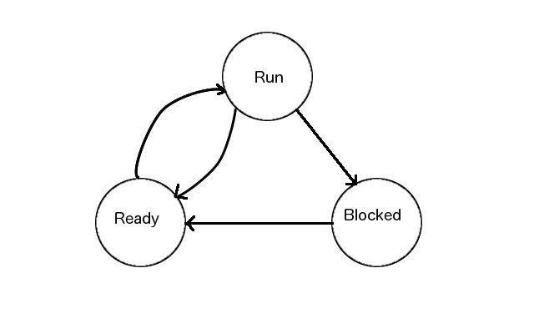
Process States
Processes can exist in one of three states
Run, Ready, or Blocked/Wait

Slide 12
Process States
Processes transition for run to ready by being interrupted
Processes transition from ready to run by ending a time slice or being preempted
Processes transition from run to wait/blocked on requesting an unavailable resource
Processes transition from wait/blocked to ready on receiving the necessary resource and being rescheduled

Slide 13
Process Control Block (PCB)
A Process Descriptor or Process Control Block (PCB)
Is created with each new process
Contains all data about a process
OS Queues use a reference (pointer) to a process descriptor so they do not need to store the entire PCB

Slide 14
PCB
+-------------------------------------------+
| name | PID |
+-------------------------------------------+
| process owner/ user |
+-------------------------------------------+
| state (ready/run/blocked/wait) |
+-------------------------------------------+
| list of threads |
+-------------------------------------------+
| list of resources |
+-------------------------------------------+
| list of child processes |
+-------------------------------------------+
| Address space |
+-------------------------------------------+
| privileges or permissions |
+-------------------------------------------+
| CPU register image |
+-------------------------------------------+

Slide 15
UNIX PCB
+-------------------------------------------+
| PID |
+-------------------------------------------+
| User |
+-------------------------------------------+
| state (ready/run/blocked/wait) |
+-------------------------------------------+
| CPU Registers |
+-------------------------------------------+
| list of resources |
+-------------------------------------------+
| list of child processes |
+-------------------------------------------+
| parent pointer |
+-------------------------------------------+
| permissions |
+-------------------------------------------+
| Stack and code pointers |
+-------------------------------------------+

Slide 16
Threads
threads - lightweight processes
Dynamic component of processes
Often, many threads are part of a process
Current OSes support multithreading
multiple threads (tasks) per process
Execution of threads is handled more efficiently than that of full weight processes (although there are other costs).

Slide 17
Thread Descriptor
Threads have a unique identifier and their own attributes - a thread descriptor
+-----------------------------+
| Thread ID |
+-----------------------------+
| Context (Program counter |
| within the process |
+-----------------------------+
| Execution stack |
+-----------------------------+
| Local memory block for |
| local variables |
+-----------------------------+
| Reference to parent process |
| to access shared resources |
+-----------------------------+
| Execution state |
+-----------------------------+
| List of related threads |
+-----------------------------+
| Thread priority |
+-----------------------------+
| Thread specific resources |
+-----------------------------+

Slide 18
Threads
At process creation, one thread is created, the "main" thread.
Other threads are created from the "main" thread
Threads have states just like processes
ready, run, and blocked/wait
Once all threads in a process terminate, the process terminates

Slide 19
Multithreading
In a multithreaded system, many stacks and thread descriptors exist
Multiple threads may exist in one process, but the process still has only one process descriptor
There is less overhead with threads versus processes
Operations like
creating a new thread
terminating a thread
switching between threads (context switching)
communication between threads
All take less time

Slide 20
Multithreading
Threads share the code and resources of a process
There is no need to switch out the code and resources from one thread to another
This means fewer cache misses!

Slide 21
User and Kernel Threads
Like processes, threads have user level and kernel level threads.
These include Windows, POSIX, and Java threads at the user level, which have no kernel level intervention.
For user level threads, switching and scheduling is performed at the process level, not the OS level
Kernel threads include management tasks done by kernel processes
Note that a process is not necessarily blocked if one of its threads is blocked

