Slide 1
History of Computers and Performance
David Monismith
Jan. 14, 2015
Based on notes from Dr. Bill Siever and from the Patterson and Hennessy Text

Slide 2
Finishing History
ENIAC - Used punch cards
See http://en.wikipedia.org/wiki/Punched_card#mediaviewer/File:Blue-punch-card-front-horiz.png for an example

Slide 3
Von Neumann Model
John von Neumann gave us concept of stored program
This is important because von Neumann’s model is the foundation of modern computer science
von Neumann machine (Stored program concept of both data and program stored in memory)
Basic components of CPU and Main memory
CPU = ALU + Control Unit + Registers
Program and data are stored in main memory
Low level programming = AND ADD OR SUB JUMP …

Slide 4
Even More History
Older computers used vacuum tubes
Modern microprocessors consist of transistors
First solid state Transistor developed in 1947 at Bell Labs
First semiconductor transistor developed in 1954 (TI)
First metal-oxide semiconductor (MOS) 1960 (Bell labs)
Led to integrated circuit (IC) - set of electronic circuits on a small plate of semiconductor material (eventually printable)
Important because ICs can be made smaller, faster, cheaper, and to use less power
Each of these innovations led to today's computers and allowed for more abstract designs

Slide 5
Gordon Moore, Intel Corp.
Note that Gordon Moore (co-founder of Intel) coined Moore's law
The number of transistors on chip doubles every 18 months

Slide 6
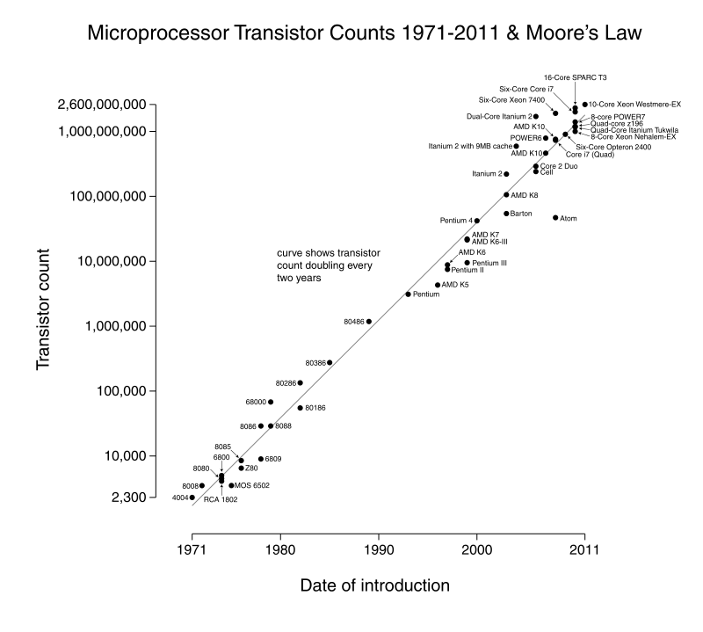
http://en.wikipedia.org/wiki/Moore%27s_law#mediaviewer/File:Transistor_Count_and_Moore%27s_Law_-_2011.svg

Slide 7
Parts of a Computer
Many of these components were developed between the 1950’s and 1970’s
Input: mouse/keyboard, gesture/touch recognition
Output: monitor, printer, LEDs, ethernet, wireless
Processor
Interconnect
Memory (primary and secondary storage)

Slide 8
Performance Evaluation
What is performance?
What is the best computer?
Processor?
Hard disk or SSD?
Memory?
Etc.

Slide 9
An Example From P&H Text
Plane | Passengers | Range (miles) | Speed (mph) | Passenger Throughput (#passengers * speed)
Boeing 787-9 | 290 | 8500 | 567 | 164430
Boeing 747-8L | 605 | 9200 | 570 | 344850
Concorde | 120 | 4500 | 1340 | 160800
Boeing 737-800 | 162 | 5510 | 511 | 82782

Slide 10
Analysis of the Example
Which is the best?
It depends upon the situation.
What about the best efficiency?
Best speed?
Best throughput?
Total work done in a given amount of time
Best for the route we are flying?

Slide 11
Performance
Choosing and understanding performance figures of merit is key to choosing the appropriate device
Speed of execution
Energy consumption
Bandwidth vs. latency
Resource cost
Many more figures of merit exist and they can be quite difficult to use

Slide 12
Energy Consumption
How power is used by the unit?
What is the amount of power per unit of computation?
Note that there is a “power wall” that currently limits the on chip clock frequency.
Clock frequency, sometimes called “speed” of the chip is related to the inverse square of the voltage applied.
Voltage applied is directly related to power, which in turn is directly related to heat.
Faster clocks = more heat
Since the late 1990’s/early 2000’s, there has been a push to add more parallelism on chip rather than higher clock speeds
Dr. Edward Bosworth provides a more detailed description of the “power wall” at http://www.edwardbosworth.com/My5155_Slides/Chapter01/ThePowerWall.doc

Slide 13
Speed of Execution and Operations per Second
What is the clock speed of your processor? 1GHz? 1.5GHz? 4GHz?
How does this compare to other systems?
Is it fair to compare a 2.5 GHz Xeon E5-2680 to a 3GHz Pentium 4? Probably not.
Another way to perform comparisons is based on:
Timing
MIPS - Millions of Instructions Per Second
FLOPS - Floating point operations per second
Not the same as MIPS processor - Microprocessor without Interlocked Pipeline Stages

Slide 14
Other Figures of Merit
Bandwidth
How much data can be transmitted over a line per unit time
Latency (Memory, Disk)
How long does it take to retrieve data (e.g. disk access time)
Resource Cost
$/GB, $/unit, $/GHz

Slide 15
Analytical vs Benchmarked (Experimental) Performance
Analytical performance computations
Rigorous analysis of computer model
Determines exact timings or exact range of timings
Not used for general purpose computers (typically only for real time systems or simple/small programs) because of difficulty
Benchmarking is done when it is not possible to compute time constraints or when there is an unknown workload

Slide 16
Benchmarked Performance Techniques
P&H defines performance as 1/execution time
For example, given two computers A and B. Run same program on both.
A task runs in 10s on A
The same task runs in 20s on B
Performance of machine A is 1/10 = .1
Performance of machine B = 1/20 = .05
More examples on the whiteboard

Slide 17
Speedup
Performance A / Performance B is Speedup
PerfA/PerfB = 2
Machine A is twice as fast as machine B for this task
This means the speedup for running this task on Machine A is 2

